Slide 1
Faith and Giving
Dr. Ishaq Zahid

Slide 2
Outline
Statistics
Relationship between Faith and Giving
Humane Aspects of Islamic Rituals

Slide 3
World Statistics on Poverty
870 million of the 7.1 billion people suffer from chronic undernourishment. (UN Food & Agriculture)
22,000 children die each day due to poverty. (UNICEF)
1.22 billion live in extreme poverty.

Slide 4
Refugees & Clean Water
45.2million refugees (UNHCR)
780 million lack access to clean water.
More than 3.4 million people die each year from water, sanitation, and hygiene-related causes.

Slide 5
Poverty in America
49 million Americans, including 15.9 million children—struggle to put food on the table.
Yet at the same time, the amount of food we waste in a given year in the USA can feed 49 million people for a year.
643,000 sheltered and unsheltered homeless people (2009)

Slide 6
W.C.S!
Waste none
Consume less
Share more

Slide 7
Belief and Giving
Relationship between Theology and Serving Humanity

Slide 8
(1) Believe (2) Give Top Two conditions of Righteousness
Believe in God, the Last Day, the Angels, the Book, and the Messengers;
(2) To spend of your substance, out of love for Him, for your kin, for orphans, for the needy, for the wayfarer, for those who ask, and for the ransom of slaves and payment of debts;
(Ref: The Quran, 2.177)

Slide 9
(1) Give (2) Believe Steep Path to Success
(1) Freeing the bondman, from debt; giving of food in a day of privation To the orphan with claims of relationship, Or to the indigent (down) in the dust.
(2) Then will he be of those who believe, and enjoin patience, and enjoin deeds of kindness and compassion. Such are the Companions of the Right Hand.” (Ref: The Quran: 90:12-18)

Slide 10
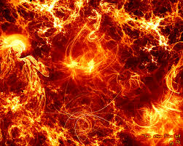
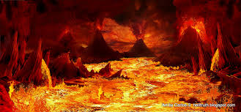
Top Two Reasons to Hell
Did not Worship Allah
Did not Feed the Needy
(The Holy Quran, 74:43-44)

Slide 11
Not Giving is Denial of Faith
Do you See one who denies the Judgment (to come)?. Then such is the (man) who repulses the orphan (with harshness), And encourages not the feeding of the indigent. So woe to the worshippers. Who are neglectful of their prayers. Those who (want but) to be seen (of men). But refuse (to supply) (even) neighborly needs. (The Glorious Quran, Chapter 107)

Slide 12
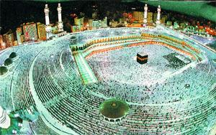
Humane Aspects of Islamic Rituals
Prayers (Salah)
Charity (Zakat)
Fasting ( Siyam)
Pilgrimage (Hajj)
x= physical aspects
y= spiritual aspects
z= humane aspects

Slide 13
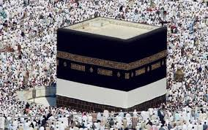
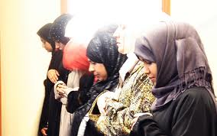
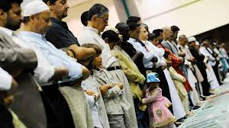
Muslim Prayer

Slide 14
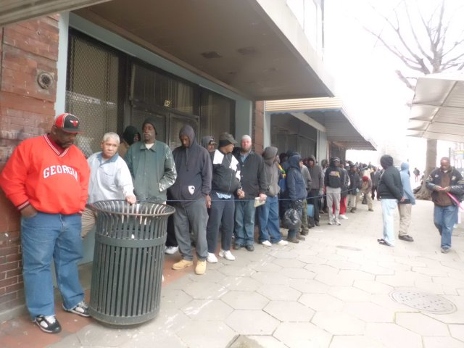
Charity (Zakat)

Slide 15
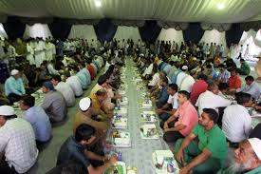
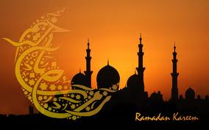
Ramadhan
Daily feast for everyone in many Mosques
Required Charity (Zakat) usually given out this month
Special Charity (Zakatul-Fitr)

Slide 16
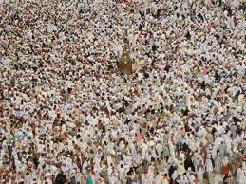
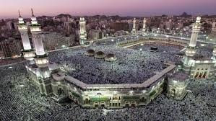
Hajj
Show of universal brotherhood as all descendants of Adam and Eve, beyond race, culture, language, social status, ethnicity
World wide give away of meat to the poor and needy

Slide 17
Charity with good heart
We feed you for the sake of Allah alone: no reward do we desire from you, nor thanks. (The Quran)

Slide 18
Share Recommendations
How to reduce poverty in your town?
Personal Experiences
Suggestions

